Slide 1

Project work-2 (CS3PC02) presentation
TARANJOT SINGH
EN18CS301281
ASSOCIATE SOFTWARE ENGINEER INTERN,
CONSULTADD INC.

Slide 2

Introduction

Slide 3


About Company:
ConsultAdd Inc is a leading provider of Information Technology consulting and business process services. We offer strategic insights, technological expertise, and industry experience. ConsultAdd is one of the fastest growing IT consulting companies specializing in finance, banking, insurance, healthcare, retail, e-commerce domains and enterprise web development, data warehouse, business intelligence, big data in technologies.
With over 150 professionals working on information technology projects across united states, ConsultAdd is headquartered in TX and has the presence in Virginia, Pennsylvania, New York. ConsultAdd's offshore center is based in India at Pune.

Slide 4
Company Profile:
Website → https://consultadd.com/
Industries → IT Services and IT Consulting
Company size → 370 employees
Revenue → $30m (2.27 Billion INR)
Headquarters → Irving, Texas, U.S.
Founded → 2011
Other Offices → In Pune, India & Canada

Slide 5
Internship Details:
Company → Consultadd Inc.
Internship Type → Off-Campus
Location → Pune, Maharashtra (Currently Remote)
Duration → 6 months
Start Date → 04/01/2022
End Date → 30/06/2022
External Guide → Mr. Gyanendra Chandrawat
(Associate Software Engineer)
Stipend→ 50k (monthly)

Slide 6

Training

Slide 7

Pre-Joining Training:
A pre-joining training was started on 13 December, 2021 to give us some familiarity with the working technologies. The training comprised of several forefront technologies like GraphQL, Microservices, PostgreSQL, Unix, MongoDB, Ticketing System (JIRA & Trello), SOAP Services & Types of Testing.

Slide 8
About Training:
A 1-month training was given on a variety of technologies to be capable of working on live projects. After that, mentors were assigned and as of now, project shadowing has started.

Slide 9

Components of Training:
Java
Front End
Python
Amazon Web Services (AWS)
Project Shadowing

Slide 10


Week 1: JAVA Training (Spring Boot)
In summary, this week we learned how to :
• Create a REST API in Spring Boot.
• Implementing Database Connectivity in it.
• Integrate spring security for user using sign in & sign up processes.
• Add test-cases for the created methods.
• Create docker image & run JAVA App in a docker engine.
•Implement config using consul & connect 2 different applications using it.

Slide 11
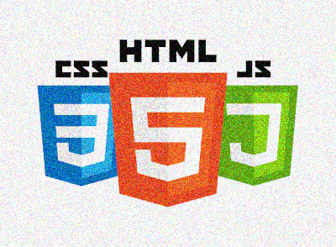

Week 2: Front End Training (HTML, CSS, JavaScript, Angular & React)
In summary, this week we learned how to :
• Create interactive web pages.
• Implement Angular & React applications using different components.
• Display data in tabular format from a GET request consisting of JSON data.
• Render child component from parent component using routing.
• Using HTTP to read & then sort that data in an Angular or React application.

Slide 12


Week 3: Python Training (Flask & Django)
In summary, this week we learned how to :
• Use Python libraries for problem solving.
• Create Flask & Django applications.
• Implement database connectivity and performing CRUD operations.
• Create REST API and how to implement GET, POST, PUT & DELETE requests using it.
• Dockerize the application.

Slide 13


Week 4: Amazon Web Services (AWS) Training
In summary, this week we learned how to :
• Implement IAM policies with JSON & define permissions.
• Create a VPC & configuring it using security groups.
• Run Windows & Linux virtual machines in cloud using Amazon EC2.
• Use serverless computing with the help of AWS Lambda.
• Implement S3 to store data as objects.

Slide 14
Project Shadowing Phase:
After the 1-month training, mentors were assigned and project shadowing was started. This allowed us to closely monitor how to deal with real-life projects, with proper guidance from our mentor. The successful completion of this phase will lead to the assigning of real-life projects.
This phase continued for around 4 weeks and afterwards, projects were assigned.

Slide 15

Project - Phase

Slide 16
Getting Started with Project:
After 4-weeks of project-shadowing, projects were assigned based on the performance in training & preferred tech-stack of every individual.
My preferred tech-stack was JAVA (Back-end)+ Angular (Front-end) + AWS (Deployment), so I was assigned a project based on these technologies.

Slide 17
Project Details:
Project Title → Consultpedia
Broad Area → Web Development + Cloud Computing
Project Start Date → 01/03/2022
Project End Date → 15/04/2022
Project Team → Epimoní̱s
Technologies Used → Java/Spring-Boot (Backend)
Angular (Frontend)
PostgreSQL (Database)
AWS RDS, Beanstalk & S3
(Deployment)

Slide 18
Project Introduction:
E-commerce is fast gaining ground as an accepted and used business paradigm. More and more business houses are implementing web sites providing functionality for performing commercial transactions over the web.
Consultpedia strives to provide solutions to develop and transfer easy and efficient way in the digital age and to help reducing the human pressure and time, to help support shop collections, the digital initiatives, and external partner institution digital projects. Consultpedia is a web application written for all operating systems, designed to help users maintain and organize shop virtually. This software is easy to use for both beginners and advanced users.
There are three actors in our application- customer, employee and manager. Customers can order products, checkout cart and view orders. Employees can add/remove products, maintain customer’s information, view & update stocks as well as can cancel/confirm the customer orders. Manager manages all the details of the customer & employee.

Slide 19
Project Objectives:
The objective of this project is to develop a general-purpose e-commerce website where any product (such as books, food items, drinks, clothes & electronic items) can be bought from the comfort of home through the Internet.
Some other objectives of the project are:
To provide a secure system application in terms of information retrieval.
To create a user-friendly interface, which will help users to buy products easily.
To properly maintain information about the employees, customers, orders and product stocks.
To have a Manager Role which can perform various operations to maintain proper functionality and transparency.
To help in decision making efficiently.

Slide 20
Features of Project:
User-friendly access
PostgreSQL provides object relational architecture as well as many more data types.
Cloud Deployment suits it for high volumes of both reads & writes.
Access control is secured because of Cloud Security.
Complete details of products from stock to prices.
Provides 3 different types of users for accessing, i.e., Customer, Employee & Manager.

Slide 21
Proposed System:
Our E-commerce website will allow the people to buy the products easily, User friendly interface.
All the products which will be listed on the website are approved by AGMARK, ISI, FPO Mark, The green & brown dot, India Organic Certification & Ecomark.
Each employee will be properly approved by the manager, otherwise he cannot login and sell medicines.
Manager can perform various operations such approve/reject employee, update employer/customer information, can see order details to maintain proper functionality and transparency.
Cash on Delivery feature also available on our website.
Payment Gateway integration for online transaction.
24 * 7 availability of the website with reliable database.

Slide 22
Scope:
A secure system application in terms of information retrieval.
A user-friendly website interface, which will help users to buy products easily.
Data Security as none of the users’ data will be shared.
Taking only necessary information from users while registering on website (no extra information).
Proper Validation check while entering information (at the time of registration, login or while changing any other information) which will restrict users’ from entering any false information.
Proper authorization of employees by manager. So, only valid employees can add products as this issue is concerned with people.
Proper functionality and transparency of the website is maintained, as Manager can perform various operations.

Slide 23
Feasibility Study:
Financial Feasibility:
Being a website, Consultpedia will have an associated hosting cost on AWS. Since the system doesn’t consist of any multimedia data transfer (except the images of medicine), bandwidth required for the operation of this application is very low. The system will follow the standard software engineering practices. No cost will be charged from the potential customers. From these it’s clear that our project is financially feasible.
Resource and Time Feasibility:
Resources that are required for our project includes:
Programming device (Laptop)
Programming tools (freely available)
Programming individuals
So, it’s clear that our project has the required resource feasibility.

Slide 24
Technical Feasibility:
Consultpedia is an e-commerce website. The main technologies and tools that are associated with it are:
Front End: Angular Framework (JavaScript)
Backend: Spring-Boot Framework (Java)
Database: PostgreSQL
Software Used: Visual Studio Code, IntelliJ IDEA, JIRA
Deployment Tools: AWS Elastic Beanstalk, AWS S3, Beanstalk & RDS
Each of the technologies are freely available and the technical skills required are manageable. Time limitations of the product development and the ease of implementing using these technologies are synchronized. From these it’s clear that our project is technically feasible.
Social/Legal Feasibility:
Consultpedia uses freely available development tools, and provide the system as an open-source system. Only the maintenance cost will be charged from potential customers. Java packages, servers, Angular libraries, AWS services that are used in this system are free & open-source.

Slide 25
Risk Feasibility:
Risk feasibility can be discussed under several contexts:
Risk associated with size: As the system, doesn’t contain any multimedia aspect (except the images of medicine), the file sizes and the complete project size will not exceed 500MB.
Business impact risks: The project Consultpedia will have several deadlines and deliverables that are scheduled successively.
Process issue risks: Consultpedia will follow the Agile software development process. This provides the flexibility to accommodate changing software requirements of it.
Development environment risks: Software Project Management tools are available for free which will help in analyzing & designing, compiling & code-generation, testing, database management.

Slide 26
Functional Requirements:
Customer can register on the website.
It is necessary that the manager must approve employee for the first time and only after a successful approval, he will be able to login to the website.
Manager can login and see the details about the Employees, Customers, Stocks and Orders.
Manager, Employee and Customer can forget and change password.
Manager can update & delete customer information, employee information and orders information.
Employee can add products, view & update stock, cancel/finish customer orders.
Customer can order products, make payments, view past orders.

Slide 27
Non-Functional Requirements:
Usability: The website has an easy-to-use interface to enhance customers experience and hence users can smoothly crawl over the webpages.
Reliability: The system produces accurate results and hence user can rely on the data being showed to them.
Availability: As it is an online platform which will be available to users 24 hours a day, 7 days a week (24 * 7).
Performance: The system will respond to user’s action and display results immediately and takes just fraction of seconds to switch between multiple web pages.
Security: The system must prevent Customers from changing the price of products other than ordering and making payments. It must also prevent Employees from interfering other employees. Only Manager can delete customer, employee and maintain both employee and customer information. Only employee can view stock and add products. User’s data is never shared with anyone. Also, the payment information (if any) is completely secured.
Design Constraints: The system shall provide an easy-to-use Web User Interface.

Slide 28

Technologies Used

Slide 29
Spring-Boot:
Spring Boot is an open source Java-based framework used to create a micro Service. It is developed by Pivotal Team and is used to build stand-alone and production ready spring applications.
Spring Boot offers the following advantages to its developers:
Easy to understand and develop spring applications
Increases productivity
Reduces the development time

Slide 30
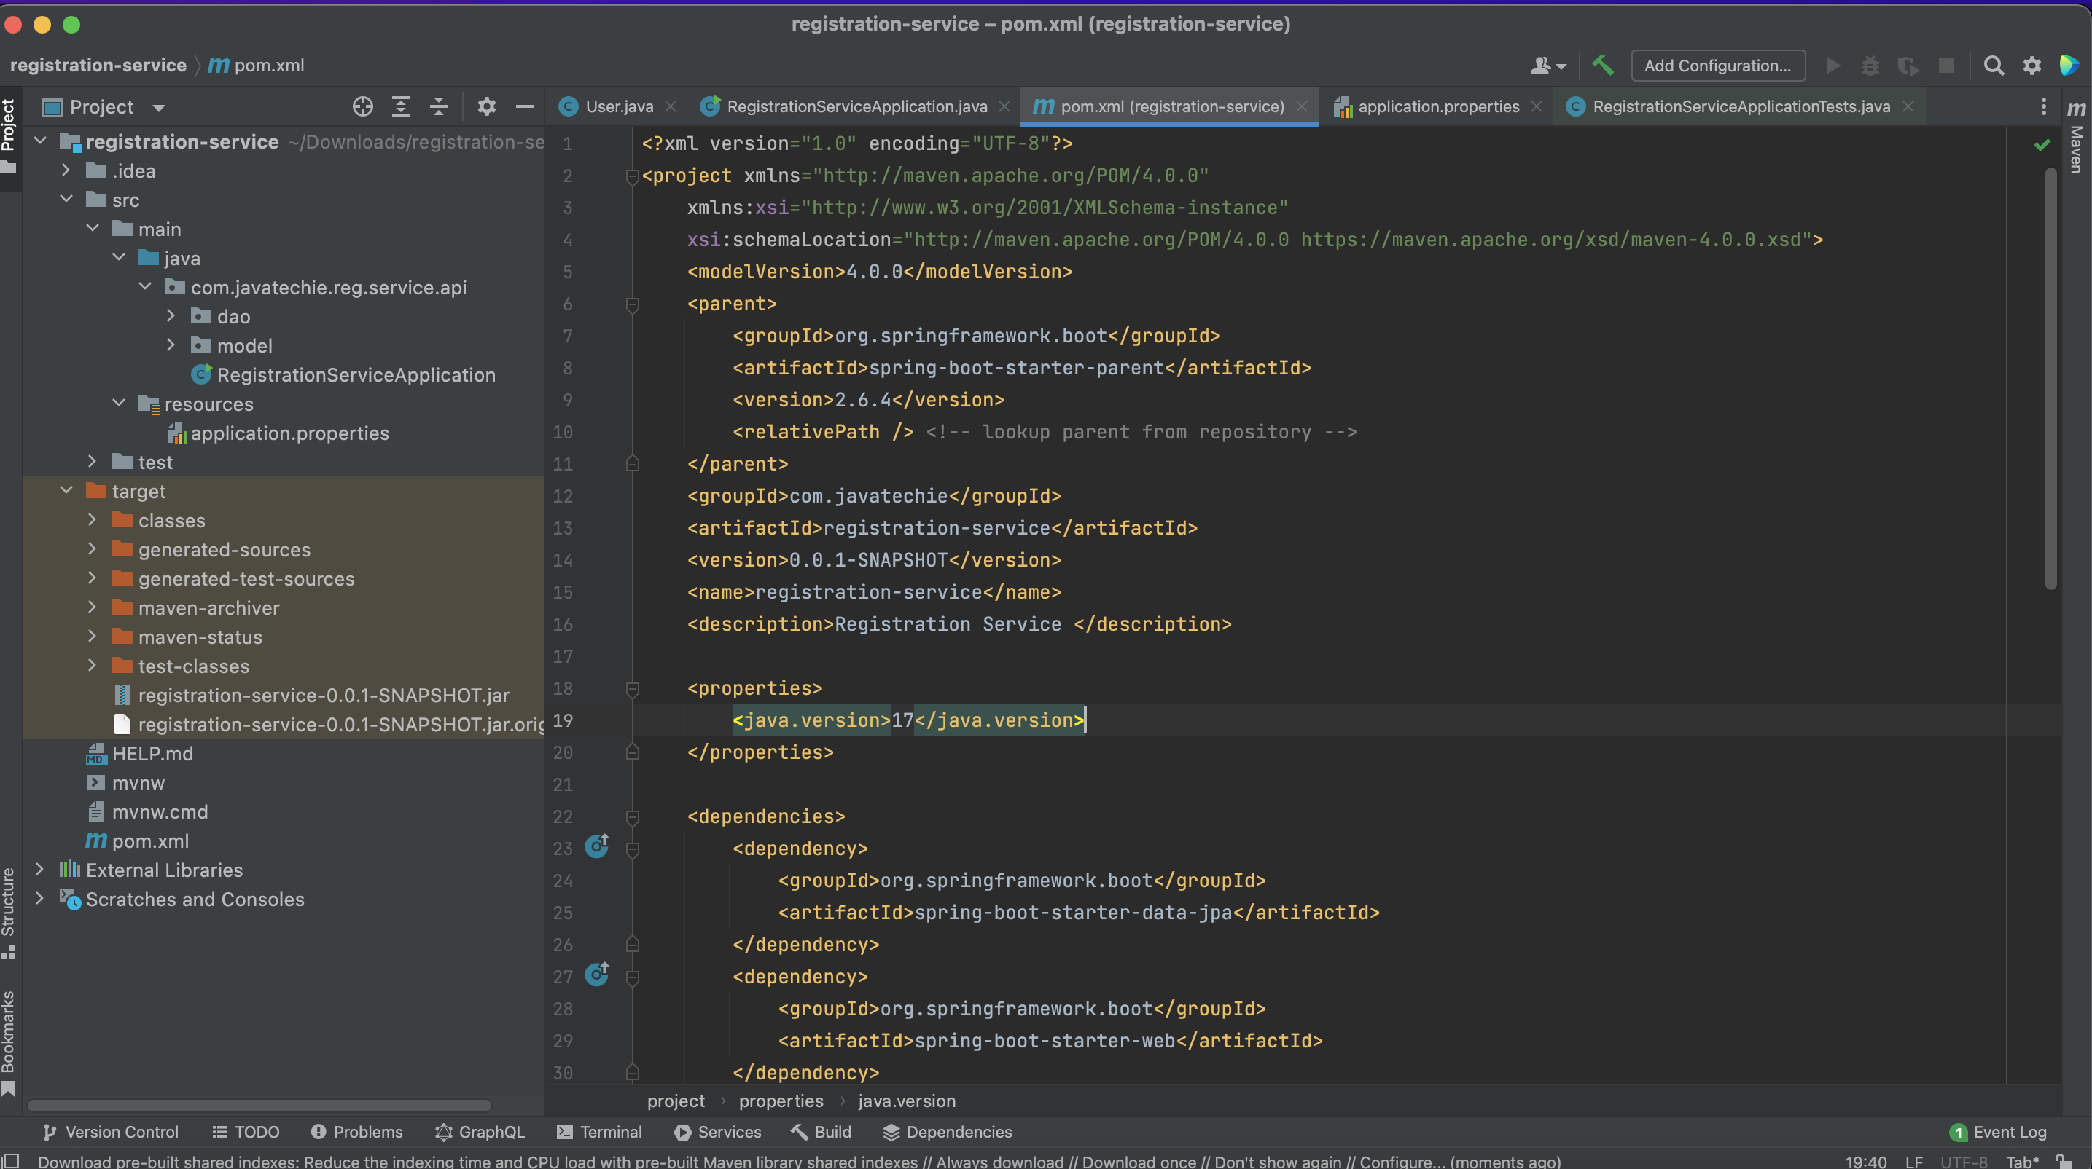
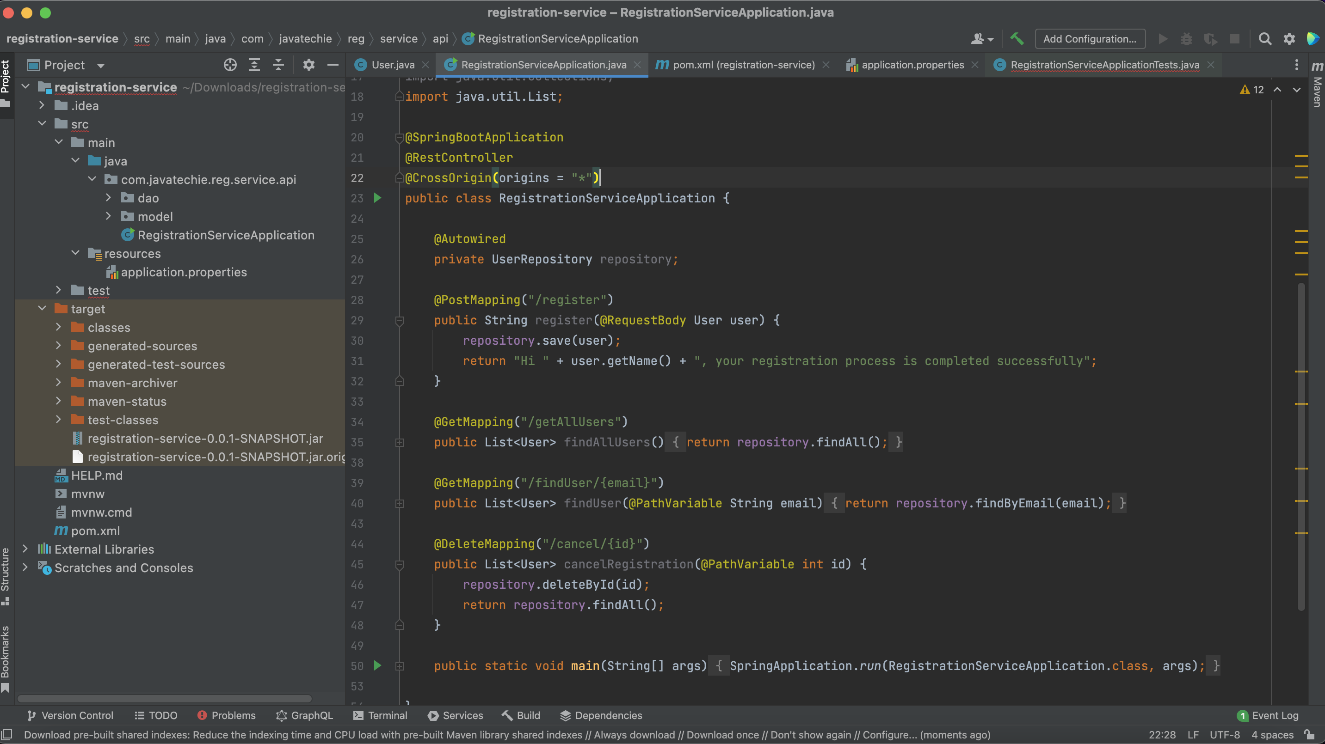

Slide 31
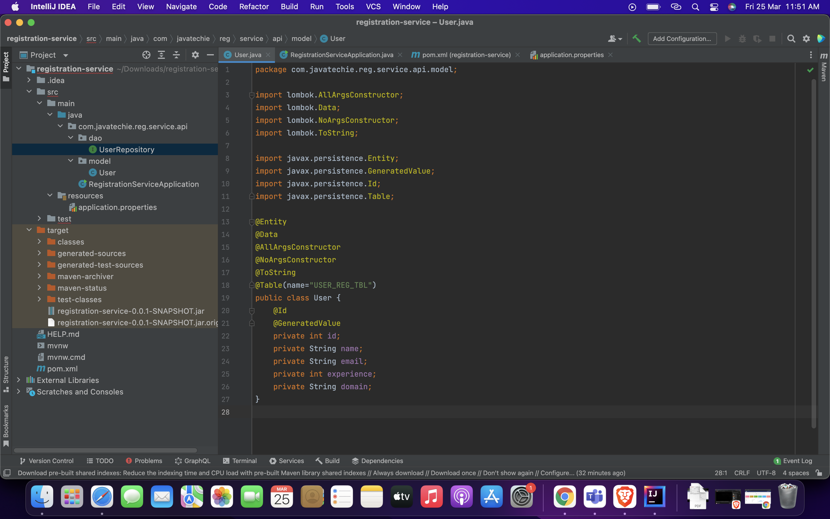
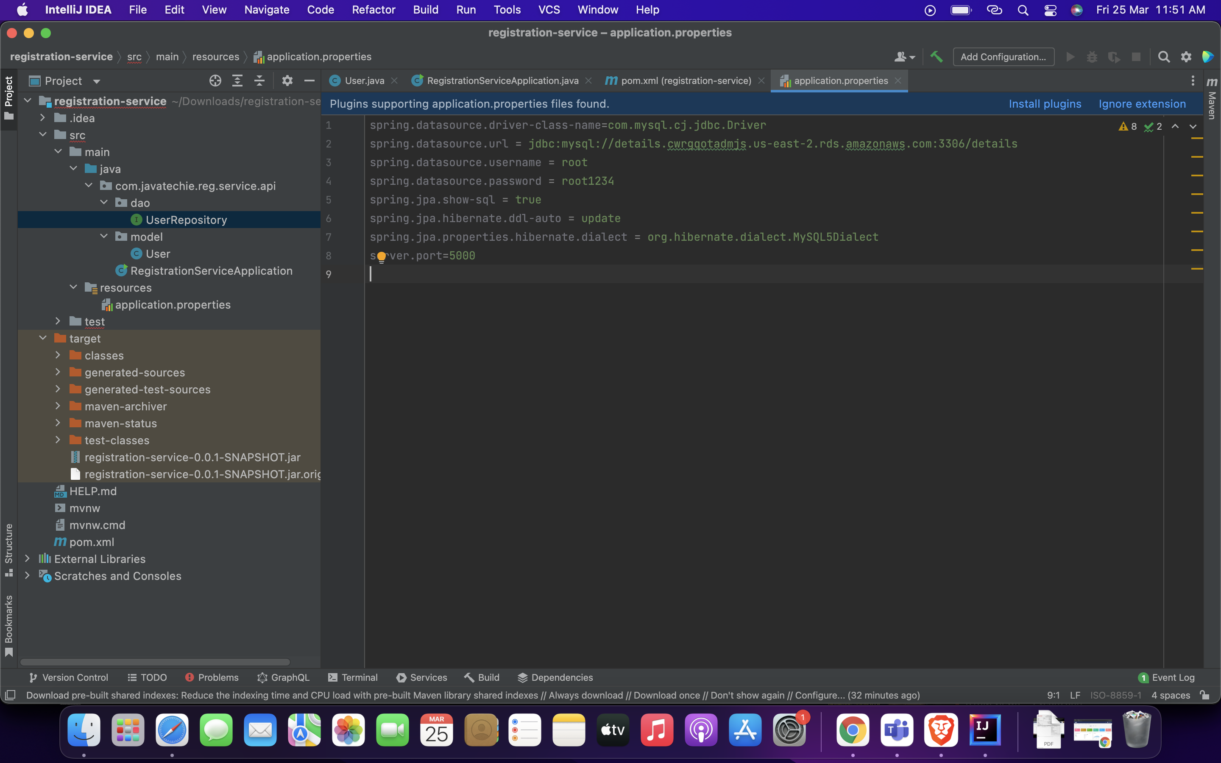

Slide 32


Angular:
Angular is a TypeScript-based free and open-source web application framework led by the Angular Team at Google and by a community of individuals and corporations. Angular is a complete rewrite from the same team that built AngularJS.
Some features of Angular are:
Cross-Platform
High Speed & Optimum Performance
Efficient Two-Way Data Binding
Less Code Framework

Slide 33
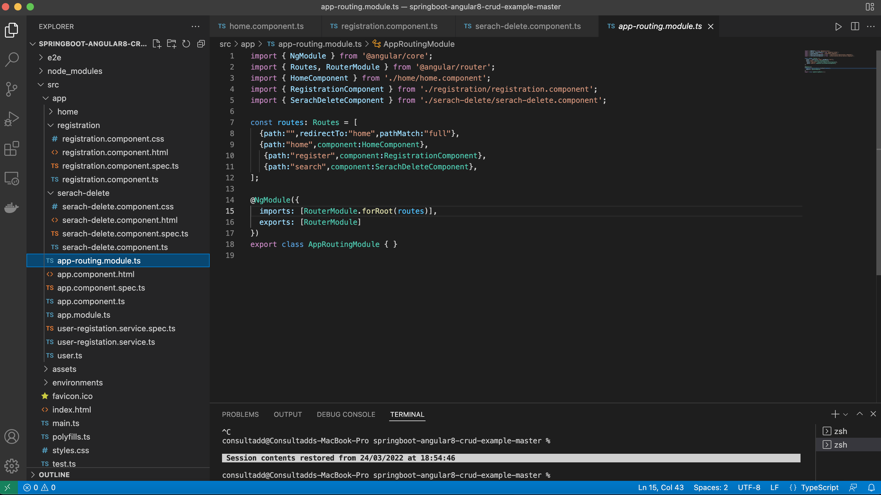
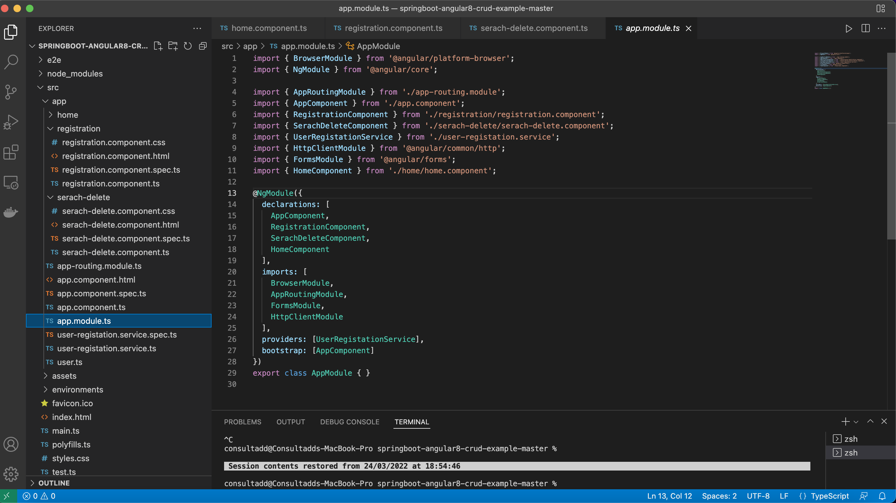

Slide 34
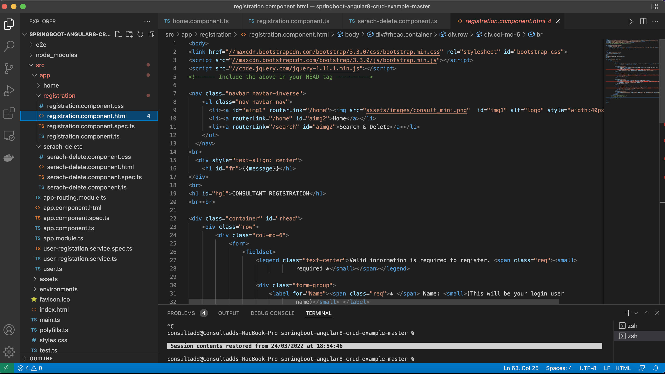
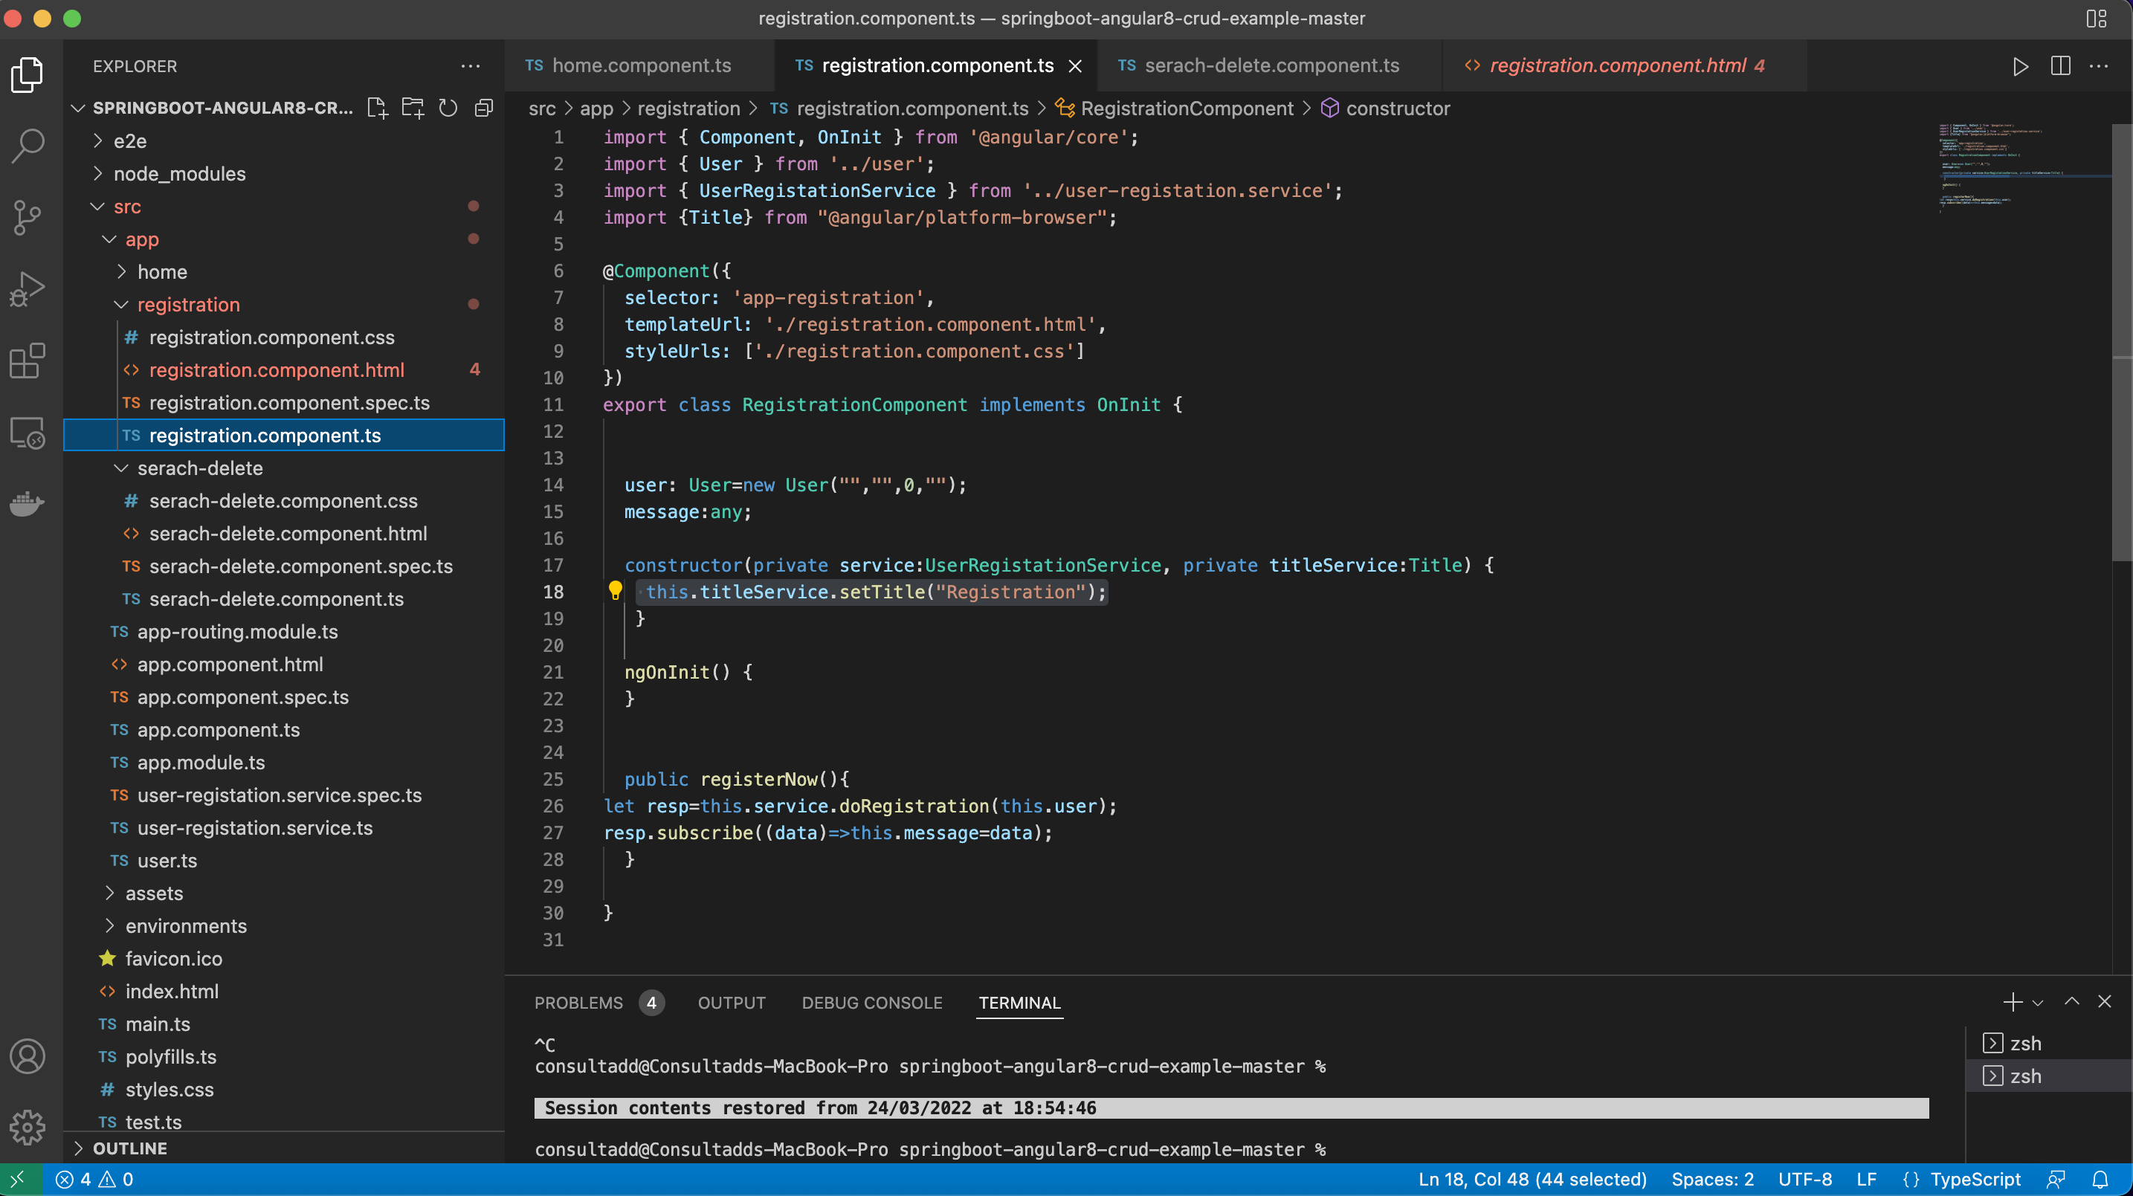

Slide 35
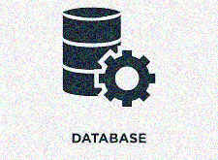

PostgreSQL:
PostgreSQL also known as Postgres, is a free and open-source relational database management system (RDBMS) emphasizing extensibility and SQL compliance. It was originally named POSTGRES, referring to its origins as a successor to the Ingres database.
Main features of PostgreSQL are:
User-defined types.
Table inheritance.
Foreign key referential integrity.
Views, rules, subquery.
Nested transactions (savepoints)

Slide 36
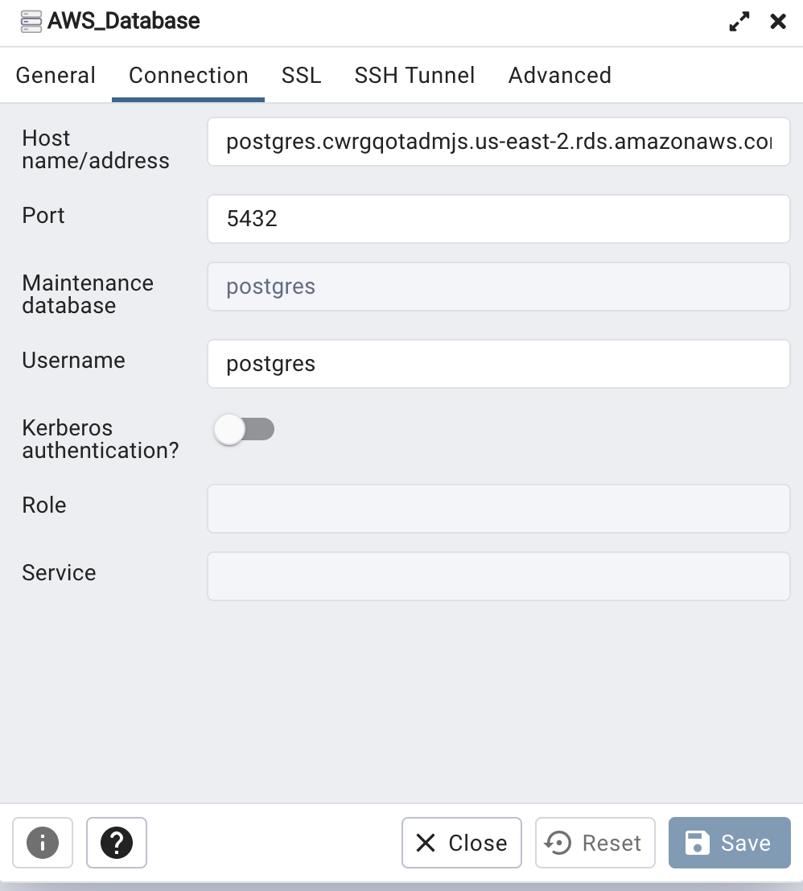

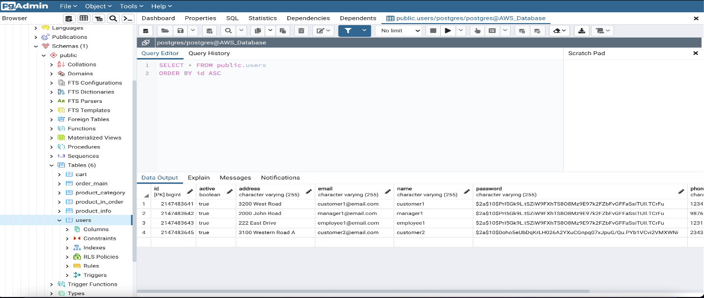

Slide 37

AWS Elastic Beanstalk:
AWS Elastic Beanstalk is an easy-to-use service for deploying and scaling web applications and services developed with Java, .NET, PHP, Node.js, Python and Docker on familiar servers such as Apache, Nginx, etc.
You can simply upload your code and Elastic Beanstalk automatically handles the deployment, from capacity provisioning, load balancing, auto-scaling to application health monitoring.
At the same time, you retain full control over the AWS resources powering your application and can access the underlying resources at any time.

Slide 38
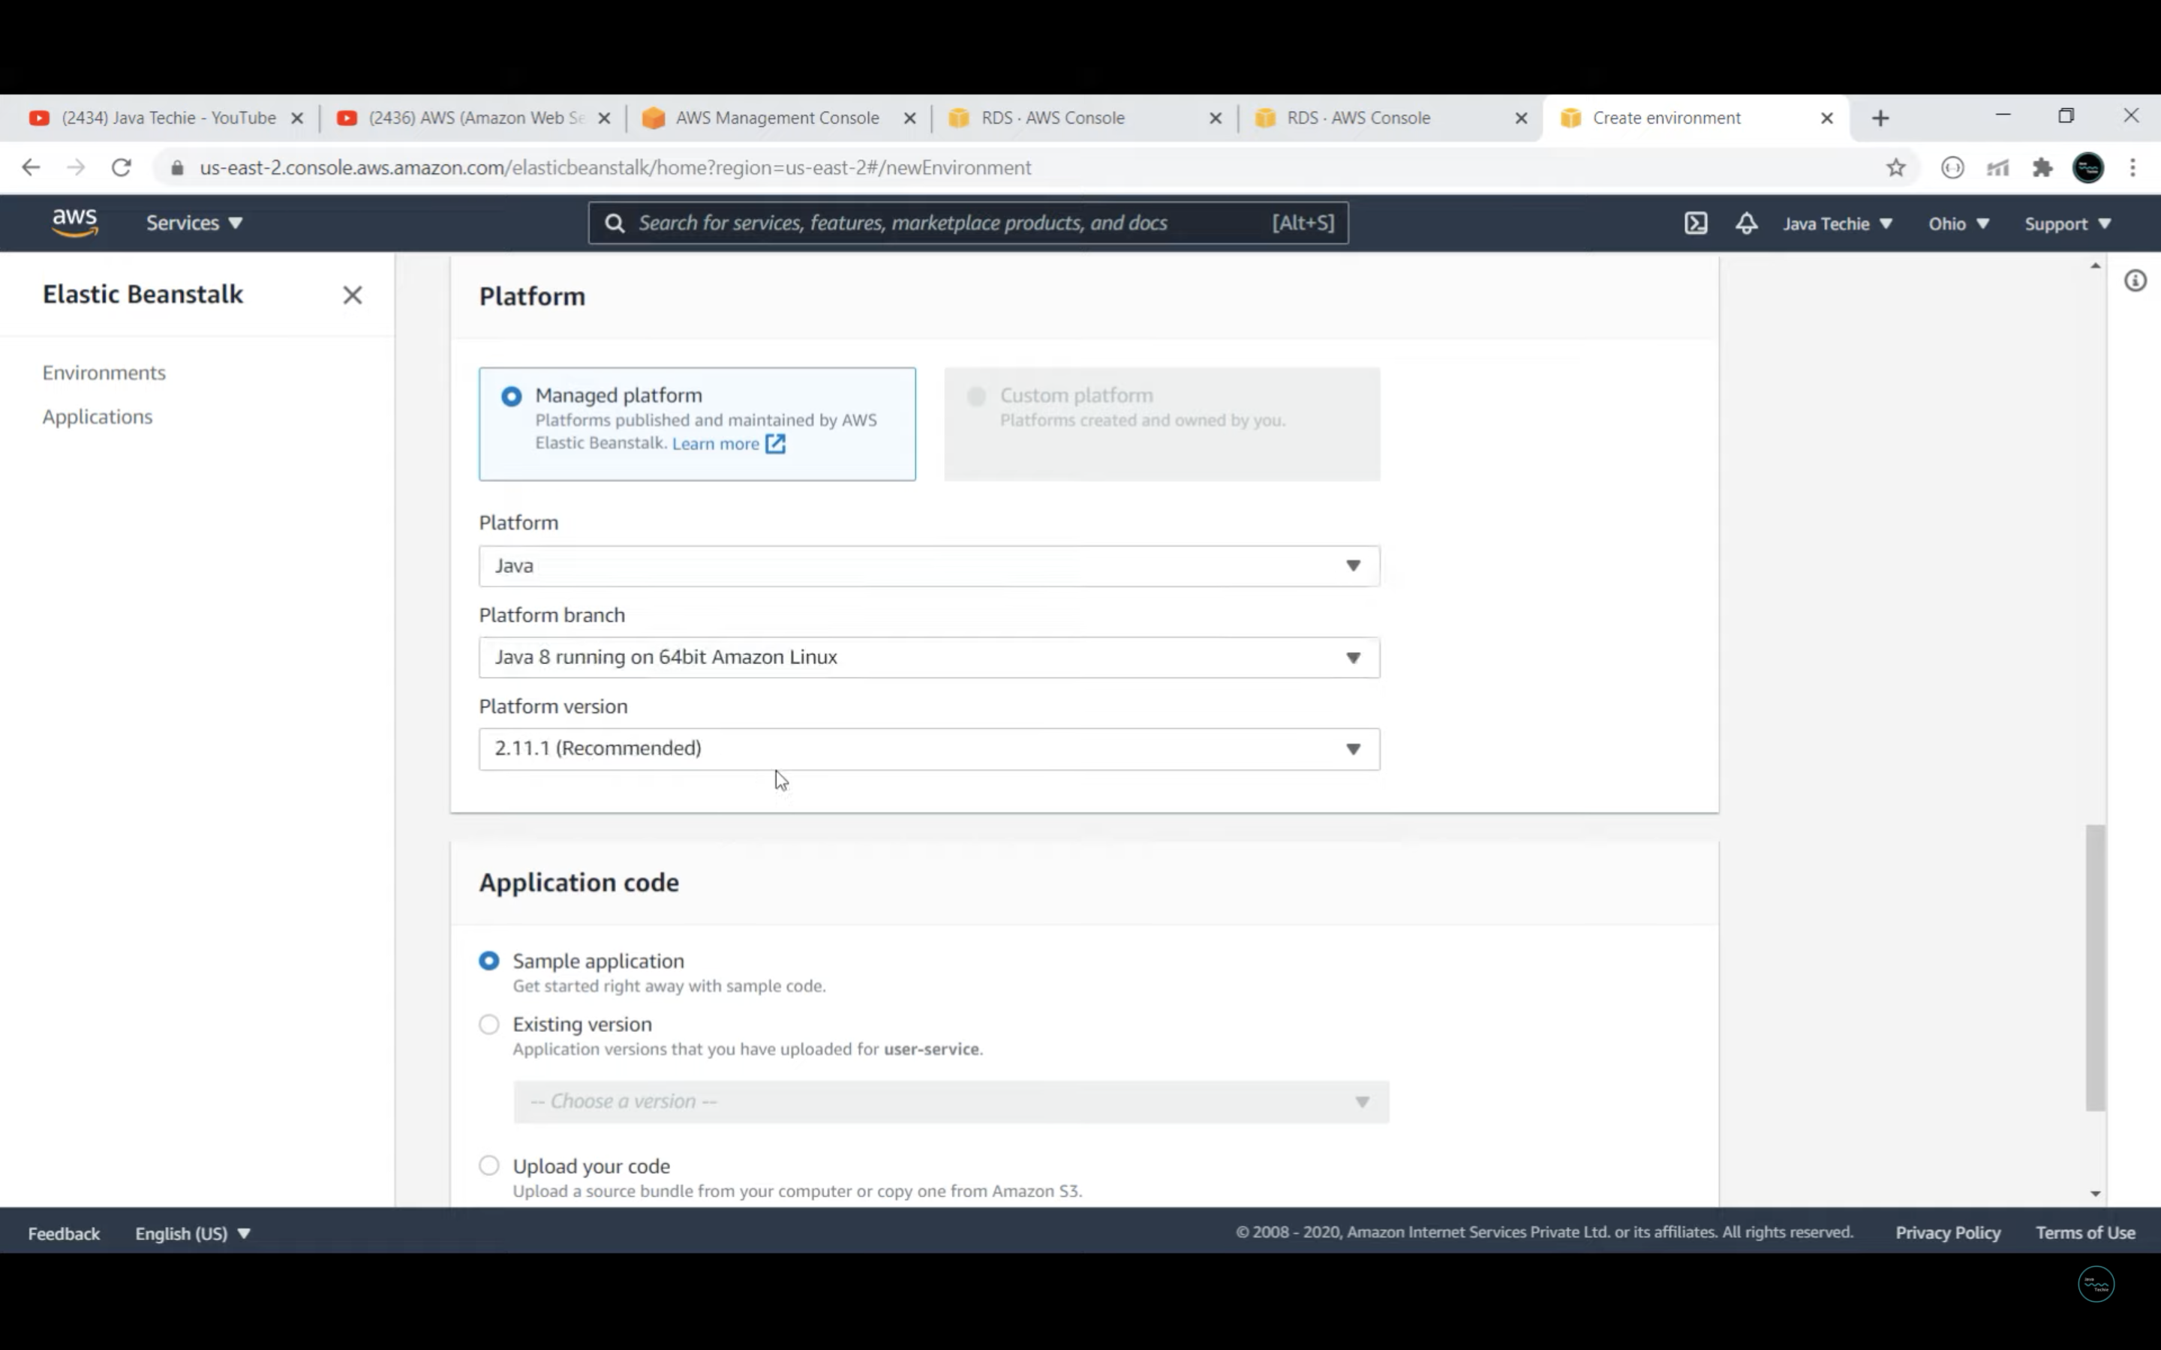
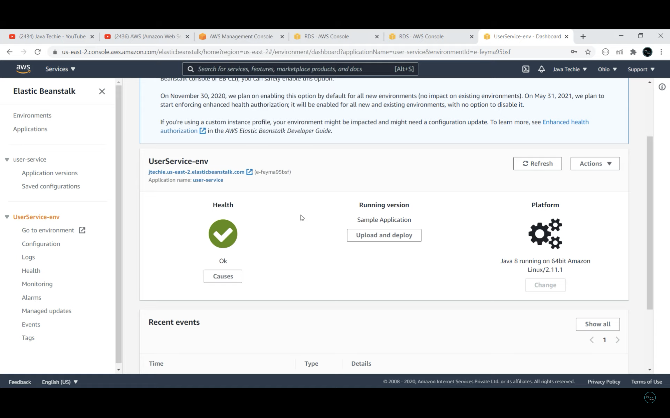

Slide 39

AWS Relational Database Service (RDS):
Amazon Relational Database Service (Amazon RDS) is a web service that makes it easier to set up, operate, and scale a relational database in the AWS Cloud. It provides cost-efficient, resizable capacity for an industry-standard relational database and manages common database administration tasks.
Amazon RDS is pay as you go. It is comprised of 3 parts:
1) Hosting
2) Storage and Operations
3) Data transferred

Slide 40
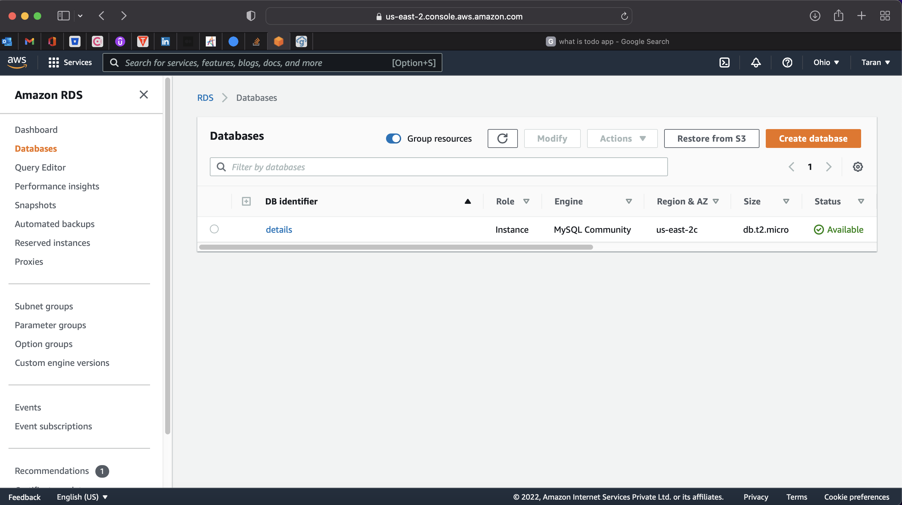
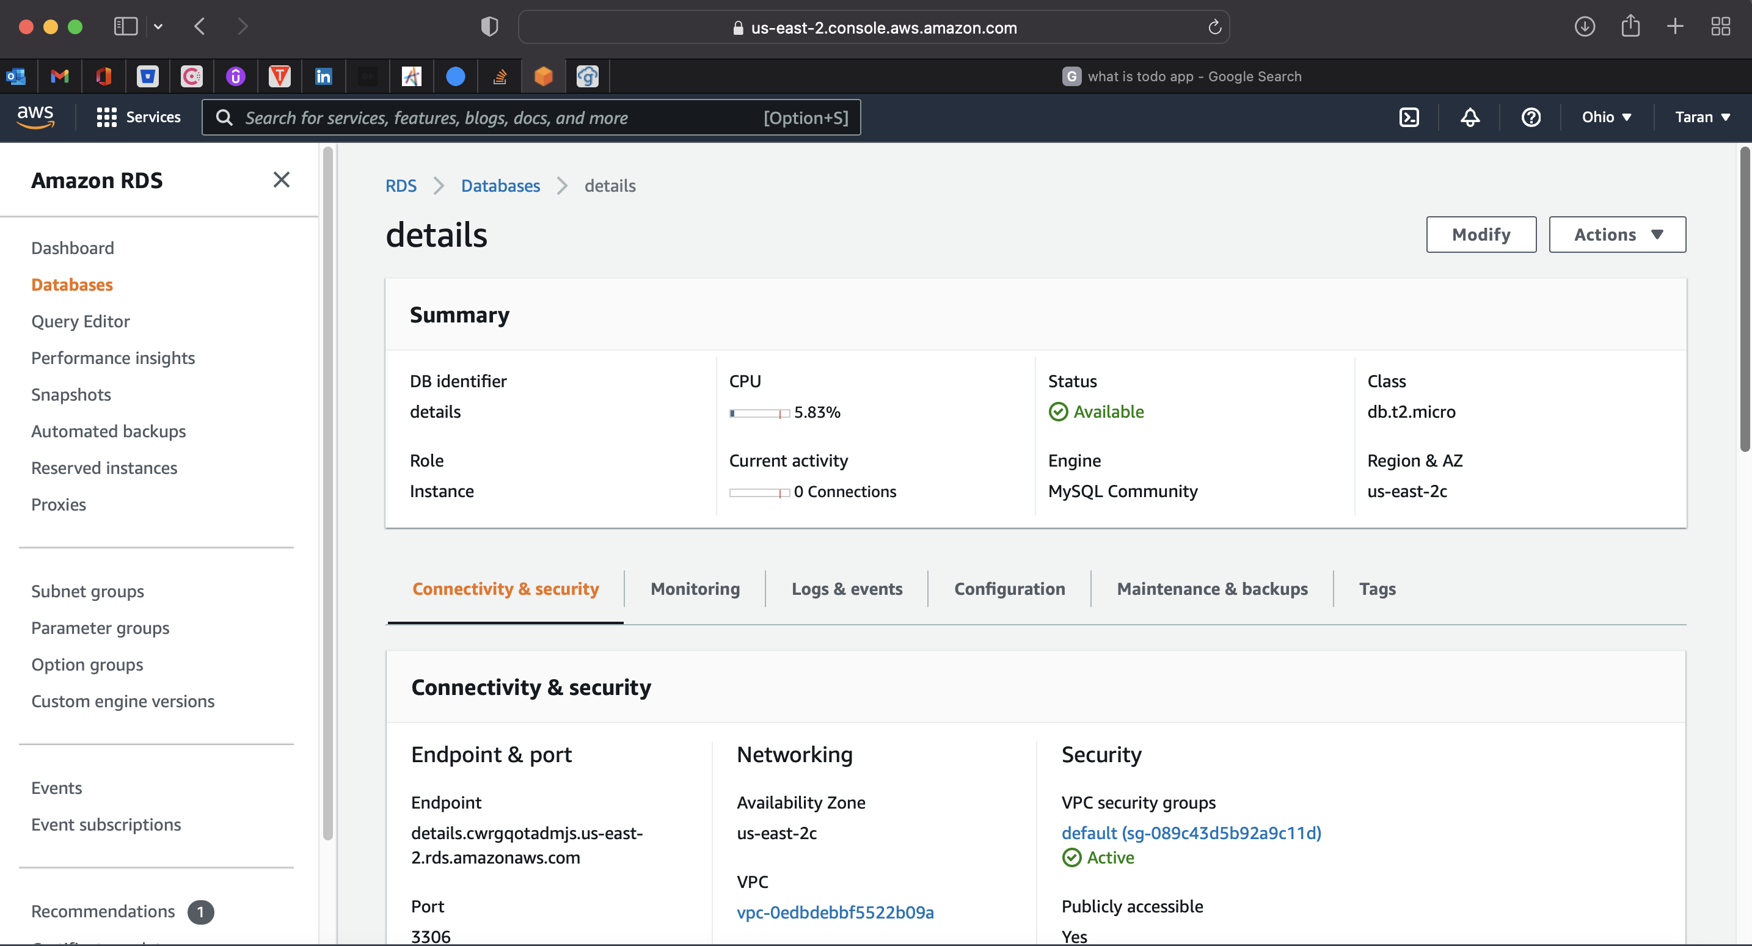

Slide 41

AWS Simple Storage Service (S3):
Amazon Simple Storage Service (Amazon S3) is an object storage service offering industry-leading scalability, data availability, security, and performance. Customers of all sizes and industries can store and protect any amount of data for virtually any use case, such as data lakes, cloud-native applications, and mobile apps.
With cost-effective storage classes and easy-to-use management features, you can optimize costs, organize data, and configure fine-tuned access controls to meet specific business, organizational, and compliance requirements.

Slide 42
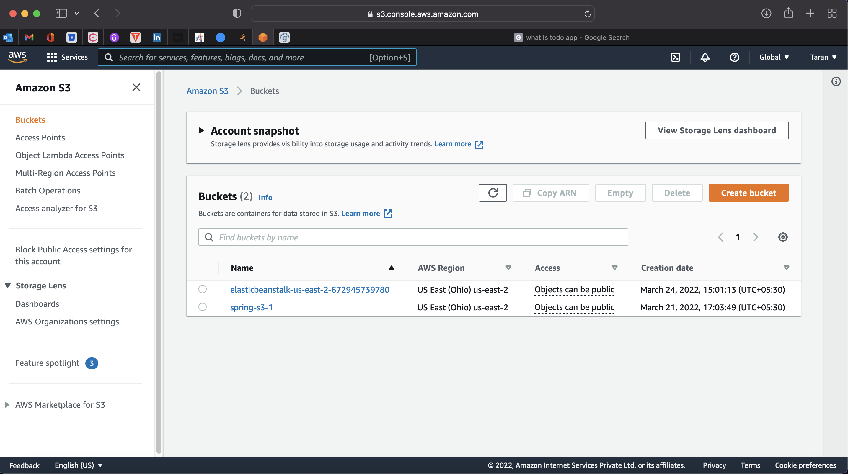
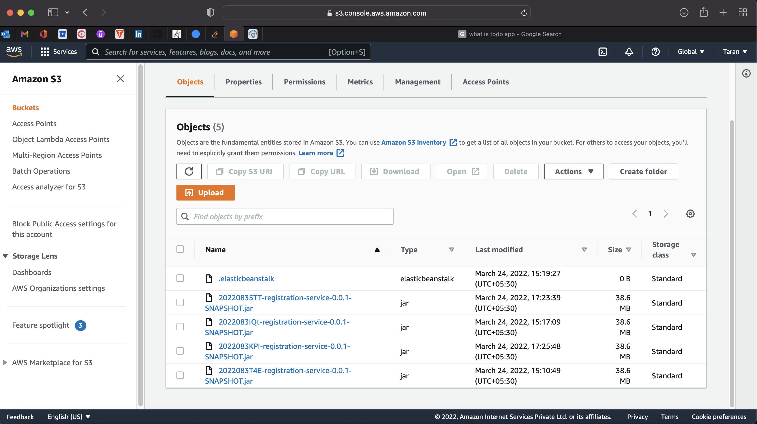

Slide 43


Visual Studio Code & IntelliJ IDEA:
Visual Studio Code is a source-code editor made by Microsoft for Windows, Linux and macOS. Features include support for debugging, syntax highlighting, intelligent code completion, snippets, code refactoring, and embedded Git. I have used it to implement my frontend code.
IntelliJ IDEA is an integrated development environment written in Java for developing computer software. It is developed by JetBrains, and is available as an Apache 2 Licensed community edition I have used it to implement by backend code.

Slide 44

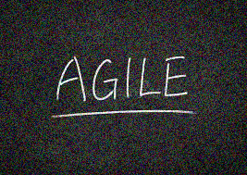
Jira Software
Jira is a proprietary issue tracking product developed by Atlassian that allows bug tracking and agile project management.
For teams who practice agile methodologies, Jira Software provides scrum and kanban boards out-of-the-box. Boards are task management hubs, where tasks are mapped to customizable workflows. Boards provide transparency across teamwork and visibility into the status of every work item. Time tracking capabilities and real-time performance reports (burn-up/down charts, sprint reports, velocity charts) enable teams to closely monitor their productivity over time.

Slide 45
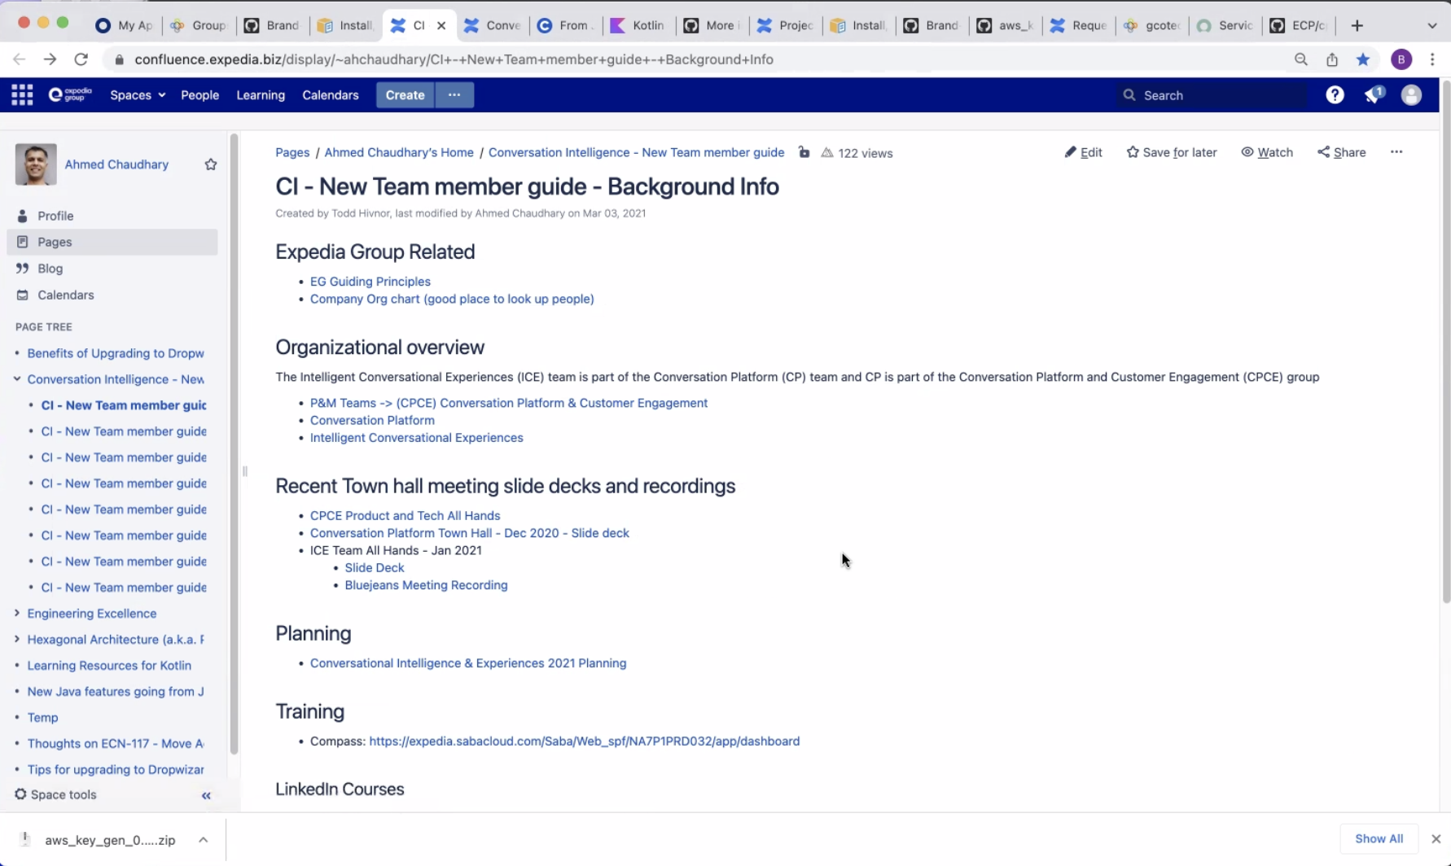
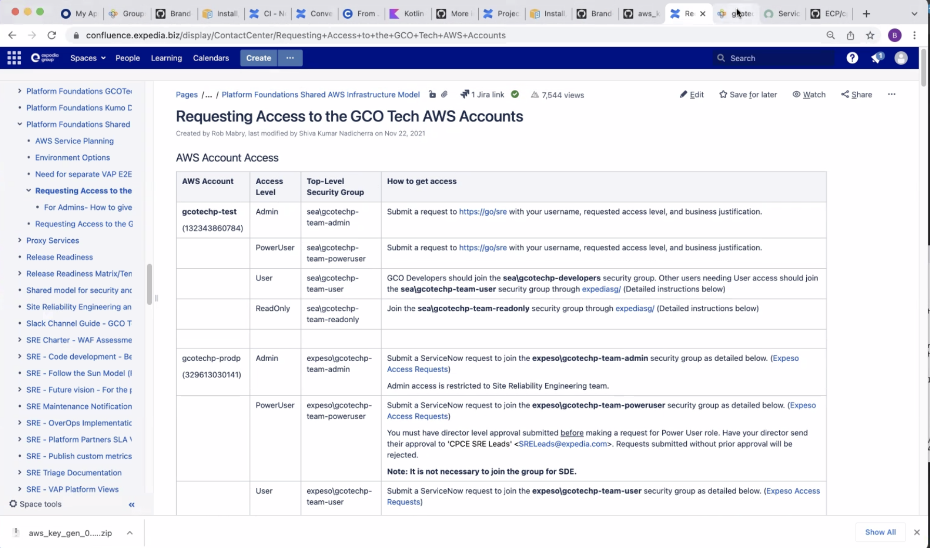

Slide 46
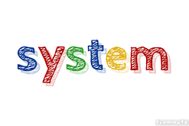
System Design

Slide 47
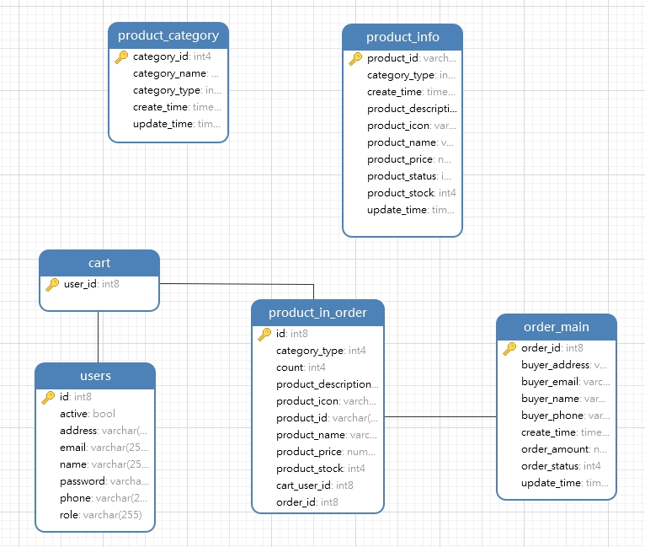
Database Design:

Slide 48
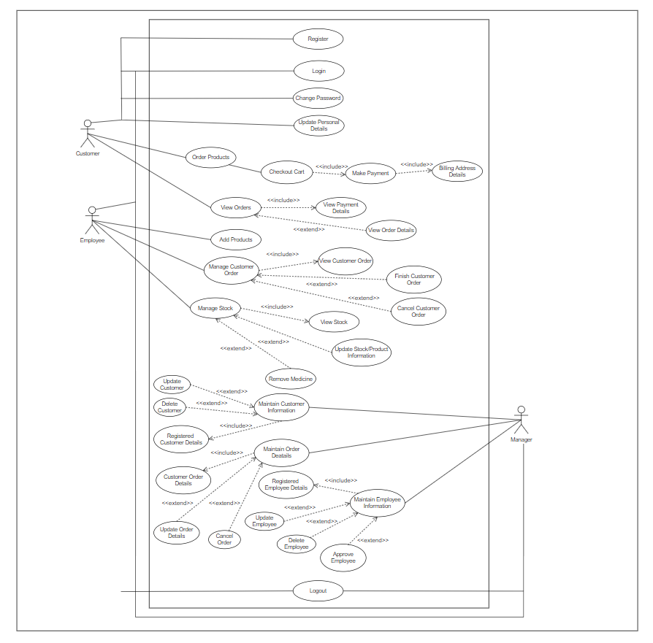
Use-Case Diagram:

Slide 49
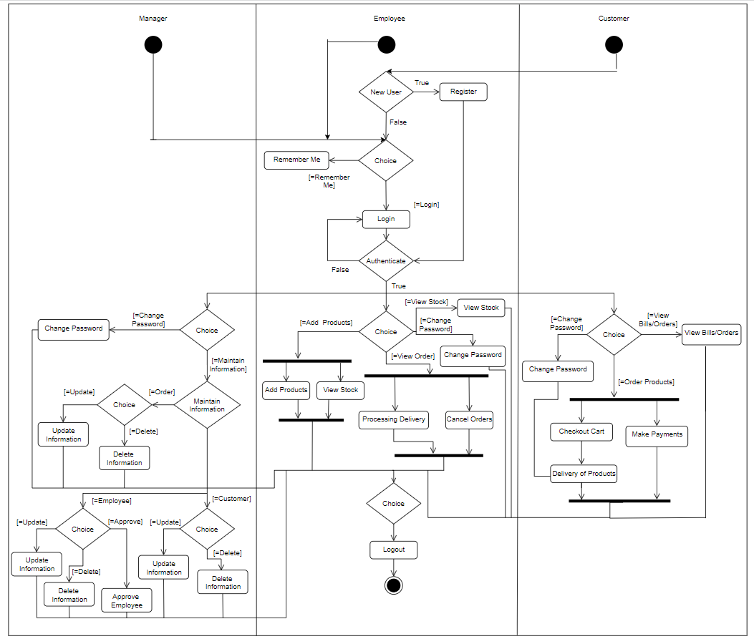
Activity Diagram:

Slide 50
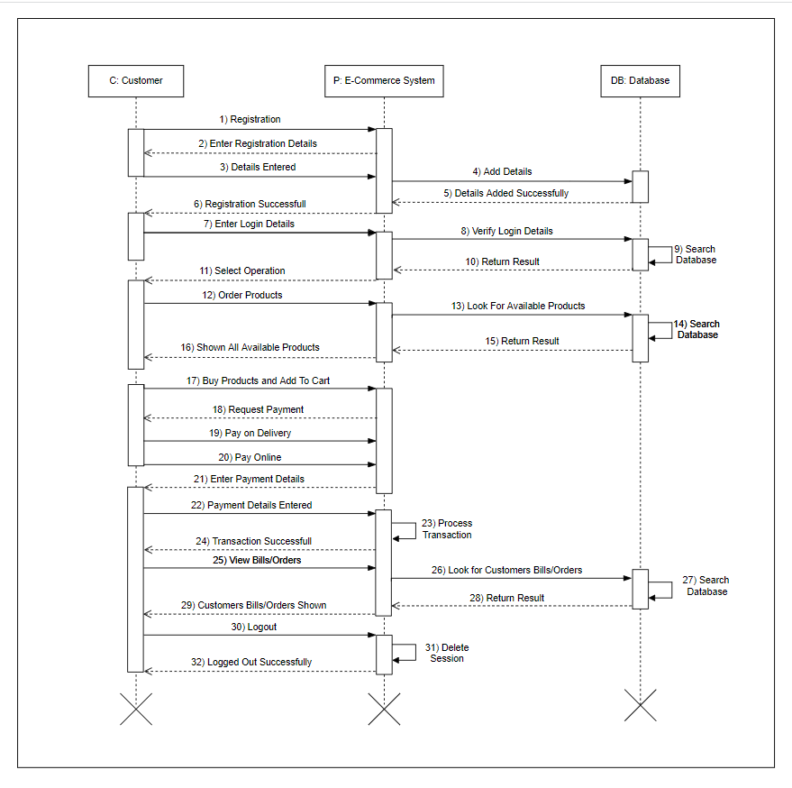
Sequence Diagram (Customer):

Slide 51
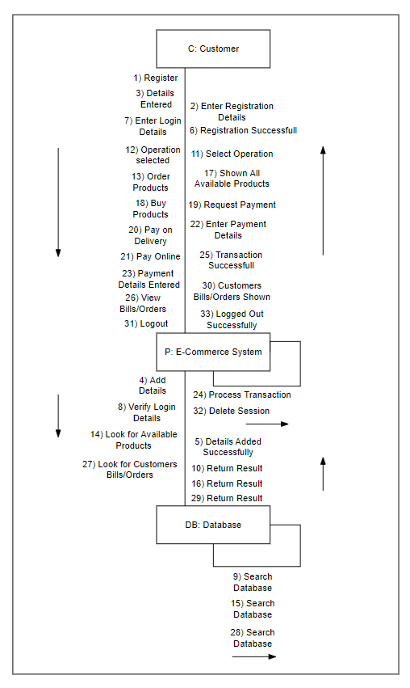
Collaboration Diagram (Customer):

Slide 52
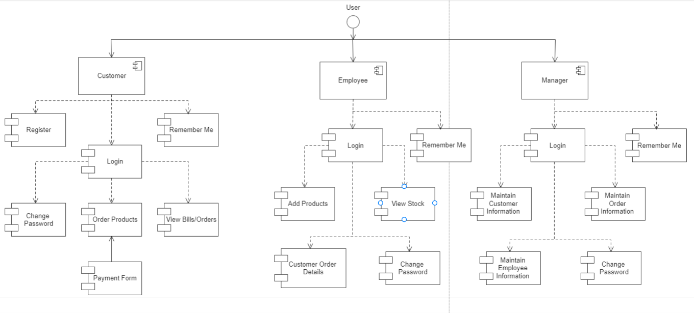
Component Diagram:

Slide 53
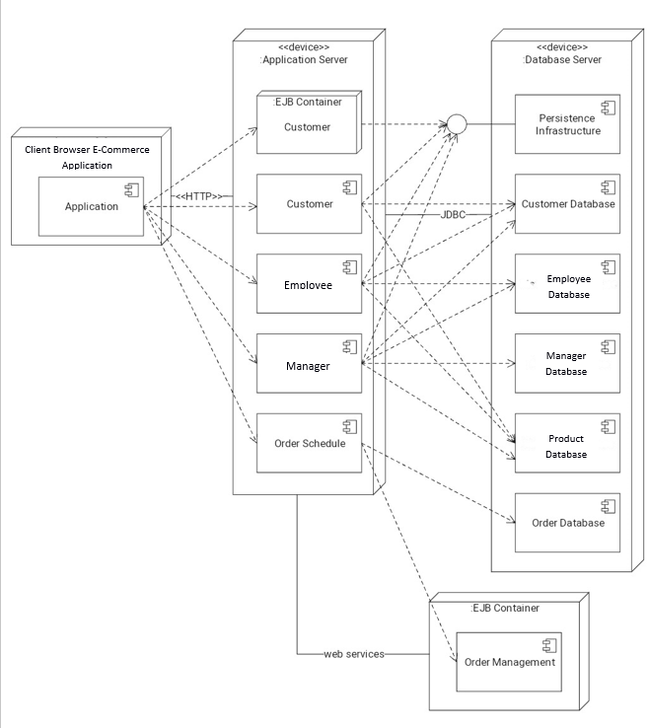
Deployment Diagram:

Slide 54

Testing

Slide 55
Testing Methods Applied:
The various types of testing which we have applied on our project are:
Unit Testing: After creating every module, we have tested each module individually whether it is working with proper functionality or not.
Integration Testing: After completion of project, we have integrated all the modules together logically and tested as a group to check after combining whether the project functionalities are working properly or not.
Black Box Testing: After making project and integrating all the modules together. We have applied black box testing to check whether all the functionalities are working correctly or not.
White Box Testing: White Box Testing is a way of testing the software in which the tester has knowledge about the internal structure or the code or the program of the software. It is mostly done by software developers.
Regression Testing: We have also applied regression testing at places where we have made some changes in the module or where we have added any new functionality.

Slide 56
Test Cases:
Manager Sign in:
Test Case ID | Test | Expected Input | Expected Output | Actual Result | Status
1. | To Sign in into the Manager Home Page | Email, Password | Login Successfully | Signed in Successfully (Manager Home Page) | Pass
2. | Trying to Sign in with wrong Email/Password | Email, Password | Not able to Sign in | Not able to Sign in | Pass
Employee Sign in:
Test Case ID | Test | Expected Input | Expected Output | Actual Result | Status
1. | To Sign in into the Employee Home Page | Email, Password | Sign in Successfully | Signed in Successfully (Employee Home Page) | Pass
2. | Trying to Sign in with wrong Email/Password | Email, Password | Not able to Sign in | Not able to Sign in | Pass

Slide 57
Customer Sign in:
Test Case ID | Test | Expected Input | Expected Output | Actual Result | Status
1. | To Sign in into the Customer Home Page | Email, Password | Sign in Successfully | Signed in Successfully (Customer Home Page) | Pass
2. | Trying to Sign in with wrong Email/Password | Email, Password | Not able to Sign in | Not able to Sign in | Pass
Change Password:
Test Case ID | Test | Expected Input | Expected Output | Actual Result | Status
1. | Entering Correct Old Password | Old Password, New Password | Password Changed Successfully | Password Changed Successfully | Pass
2. | Entering Wrong Old Password | Old Password, New Password | Password Not Changed Successfully | Password Not Changed Successfully | Pass

Slide 58
Customer Administration:
Test Case ID | Test | Expected Input | Expected Output | Actual Result | Status
1. | Deleting Customer, already registered with the system | Email | Customer Deleted Successfully | Customer Deleted Successfully | Pass
2. | Deleting Customer not registered with the system | Email | Customer Not Deleted Successfully. Please, Enter Correct Email ID | Customer Not Deleted Successfully. Please, Enter Correct Email ID | Pass
3 | Update Customer Details | Email, Password, First Name, Last Name, Address, Mobile No., D.O.B. | Customer Details Updated Successfully | Customer Details Updated Successfully | Pass
Change Password:

Slide 59
Orders Administration:
Test Case ID | Test | Expected Input | Expected Output | Actual Result | Status
1. | Cancel Order | Email | Customer Order Cancelled Successfully | Customer Order Cancelled Successfully | Pass
2. | Finish Order | Email | Customer Order Finished Successfully | Customer Order Finished Successfully | Pass
Customer Registration:
Test Case ID | Test | Expected Input | Expected Output | Actual Result | Status
1. | To Register Customer | Email, Name, Password, Phone No, Address | Customer Registered Successfully. | Customer Registered Successfully. | Pass

Slide 60
Employee Adding Product:
Test Case ID | Test | Expected Input | Expected Output | Actual Result | Status
1. | Add Product | Photo, Code, Name, Type, Description, Price, Stock, Status | Product Added Successfully | Product Added Successfully | Pass
2. | Update Product | Photo, Code, Name, Type, Description, Price, Stock, Status | Product Updated Successfully | Product Updated Successfully | Pass
Customer Registration:

Slide 61
Buy Product:
Test Case ID | Test | Expected Input | Expected Output | Actual Result | Status
1. | Buying Product | Click on Get It Button & Add to Cart | Asking for Quantity and Payment Details | Asking for Quantity and Payment Details | Pass
Manager Sign out:
Test case Id | Test | Expected Input | Expected output | Actual result | Status
1. | To Sign out from Manager Page | Click on Sign Out button | Signed out Successfully | Signed out Successfully | Pass

Slide 62
Employee Sign out:
Test case Id | Test | Expected Input | Expected output | Actual result | Status
1. | To Sign out from Employee Page | Click on Sign Out button | Signed out Successfully | Signed out Successfully | Pass
Customer Sign out:
Test case Id | Test | Expected Input | Expected output | Actual result | Status
1. | To Sign out from Customer Page | Click on Sign Out button | Signed out Successfully | Signed out Successfully | Pass

Slide 63
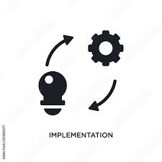
Implementation Snapshots

Slide 64
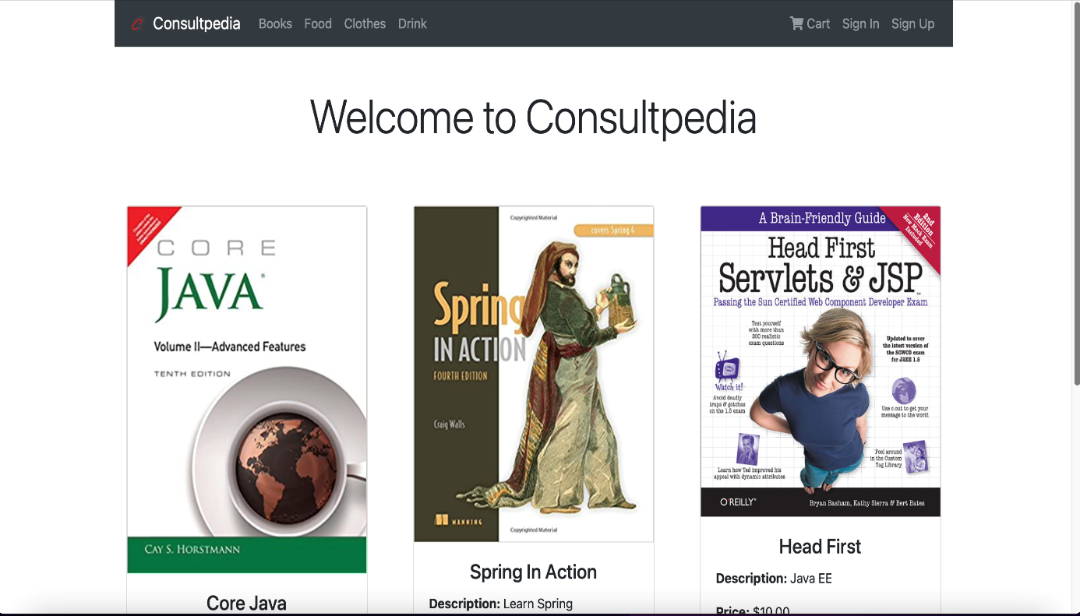
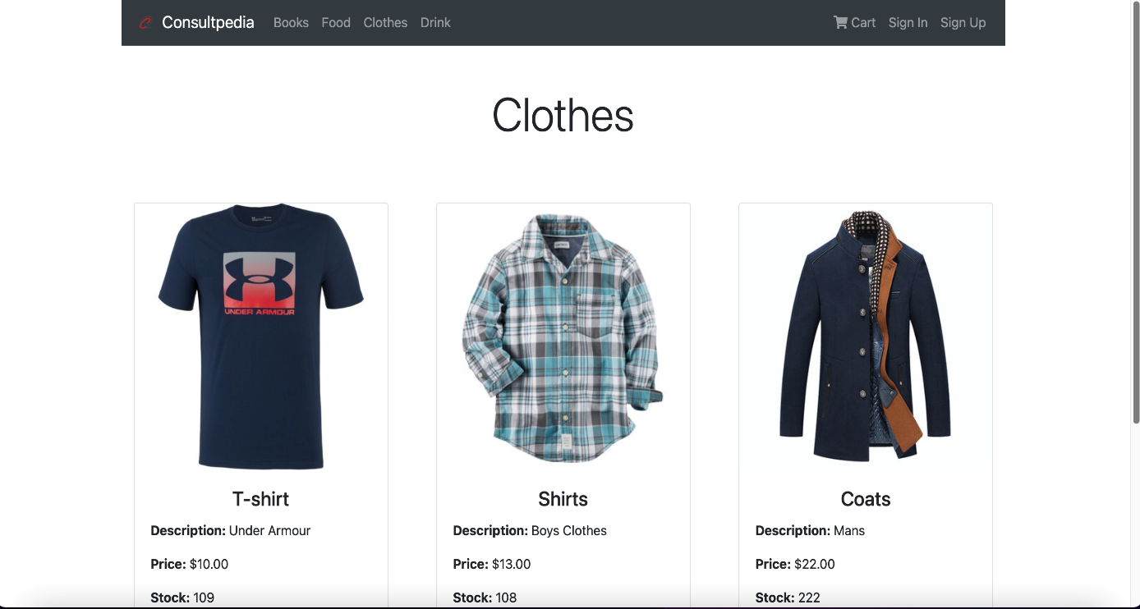

Slide 65
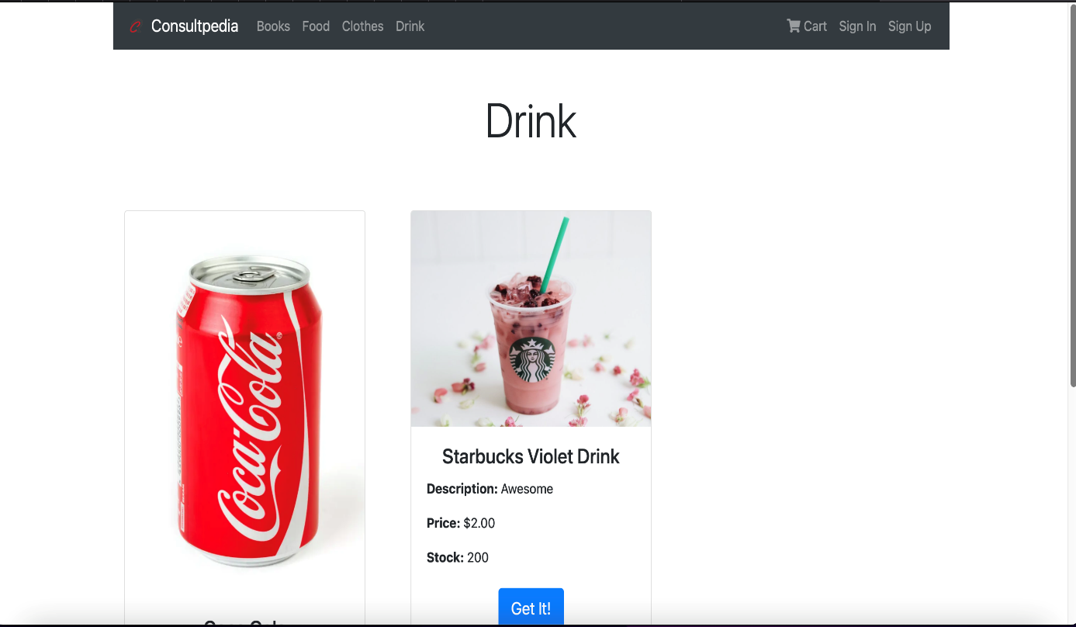
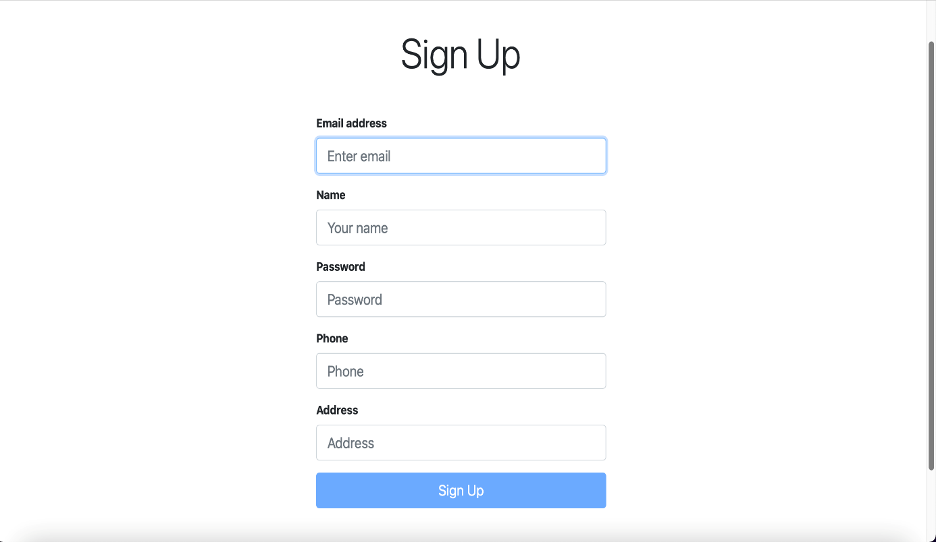

Slide 66
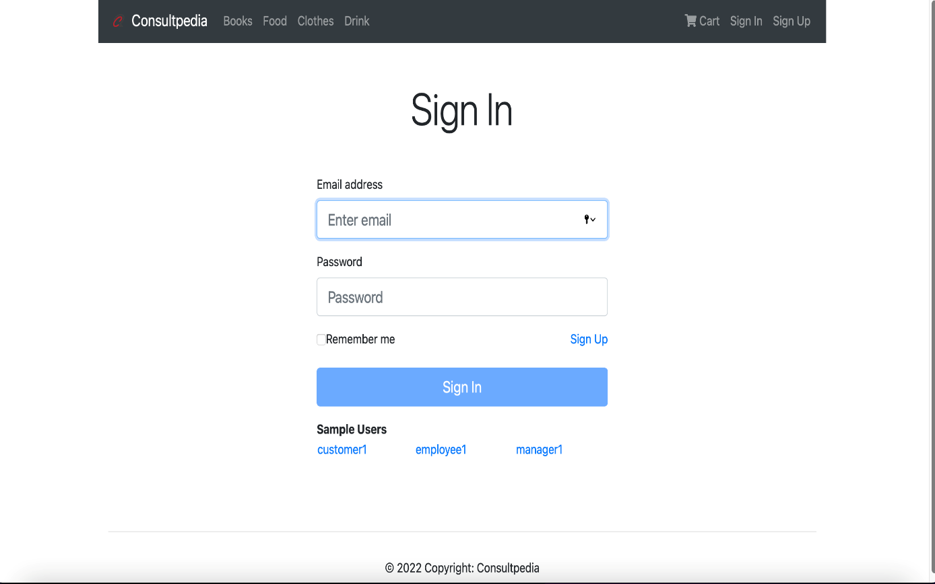
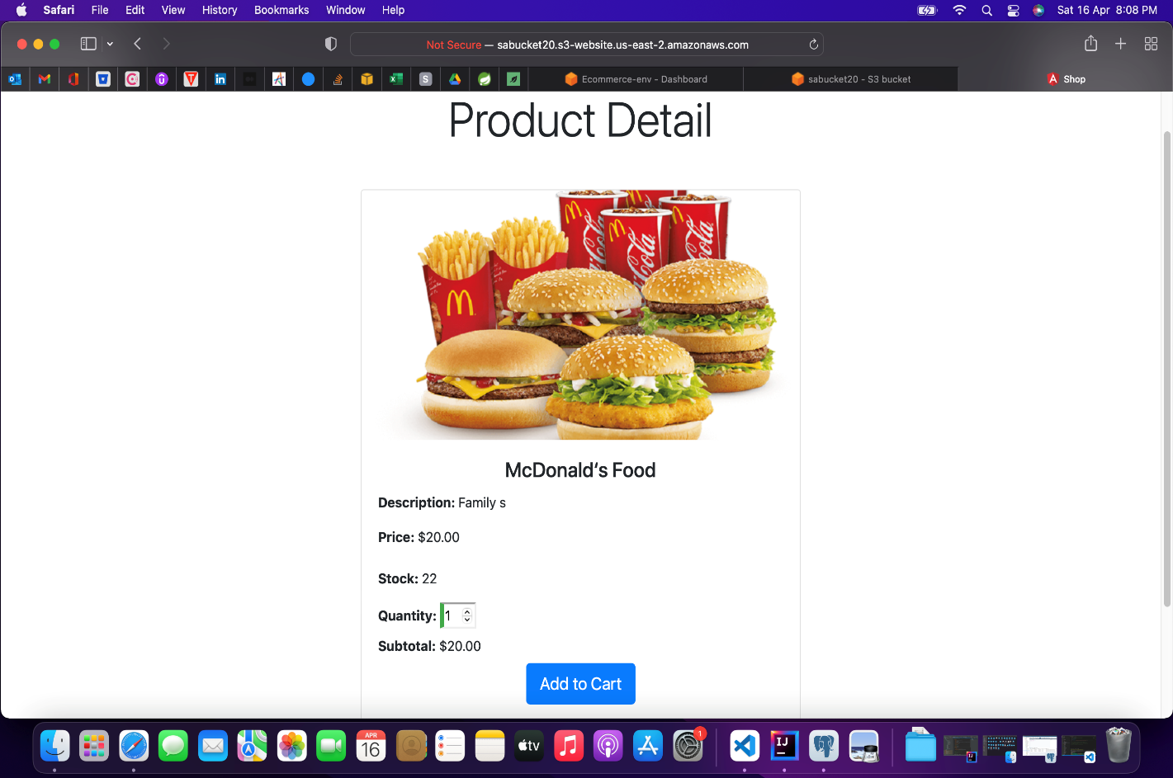

Slide 67
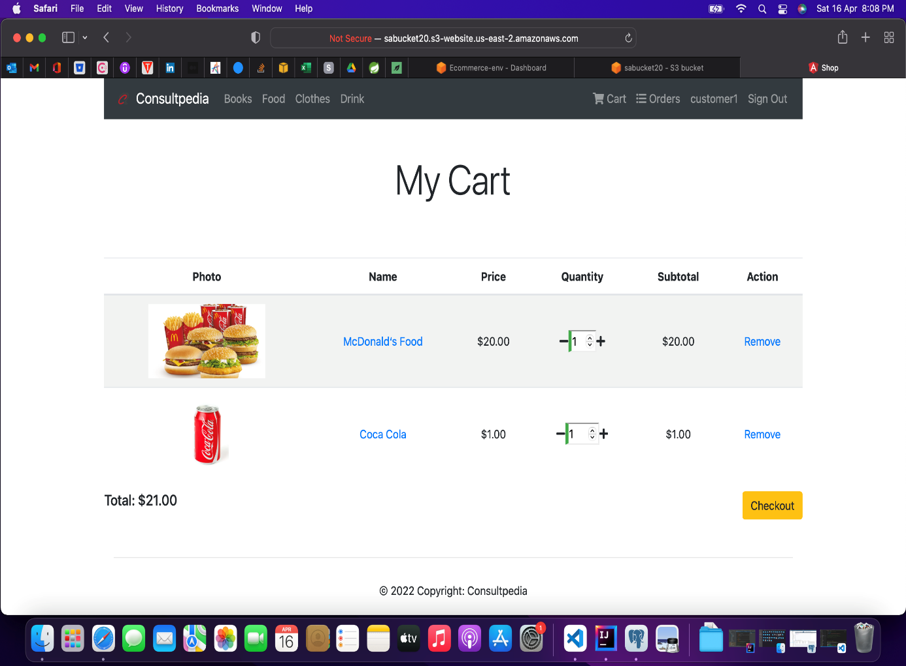
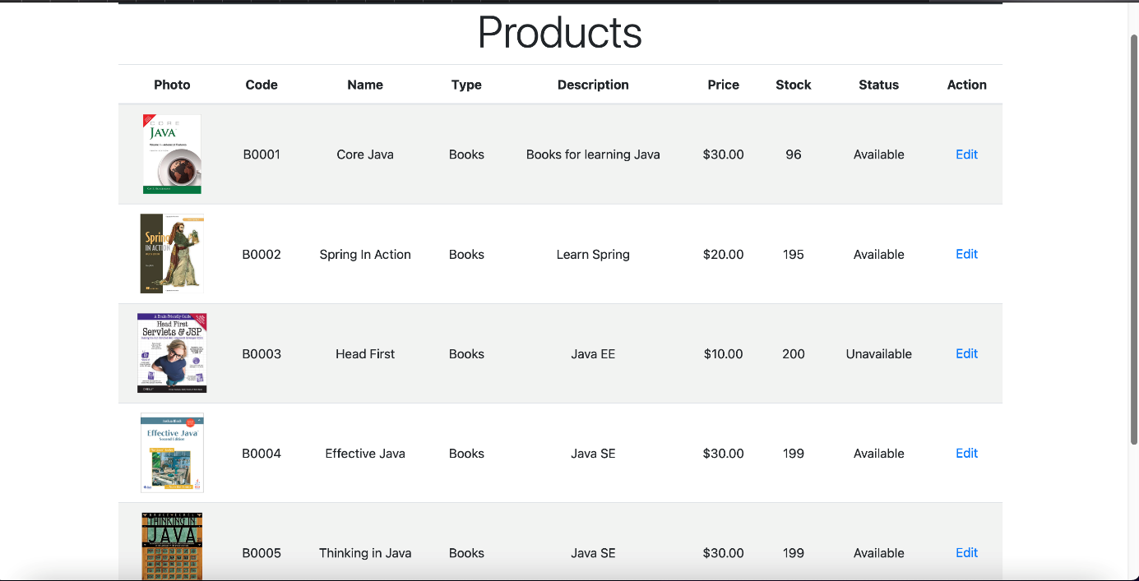

Slide 68
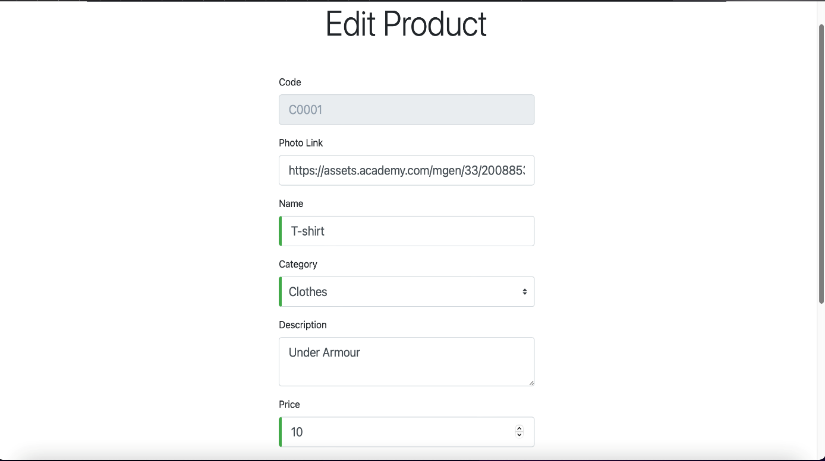
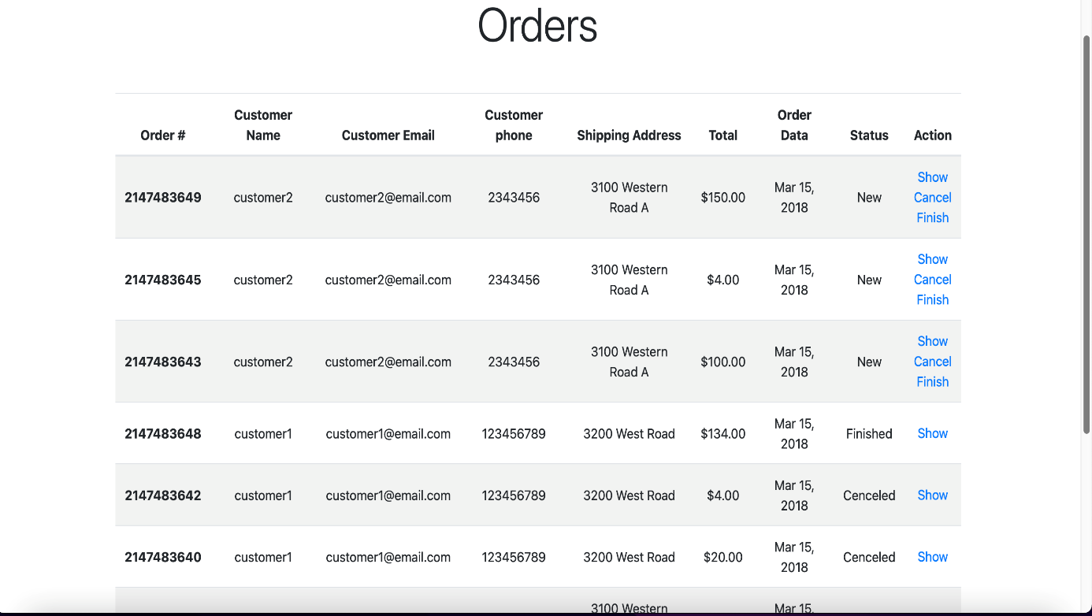

Slide 69
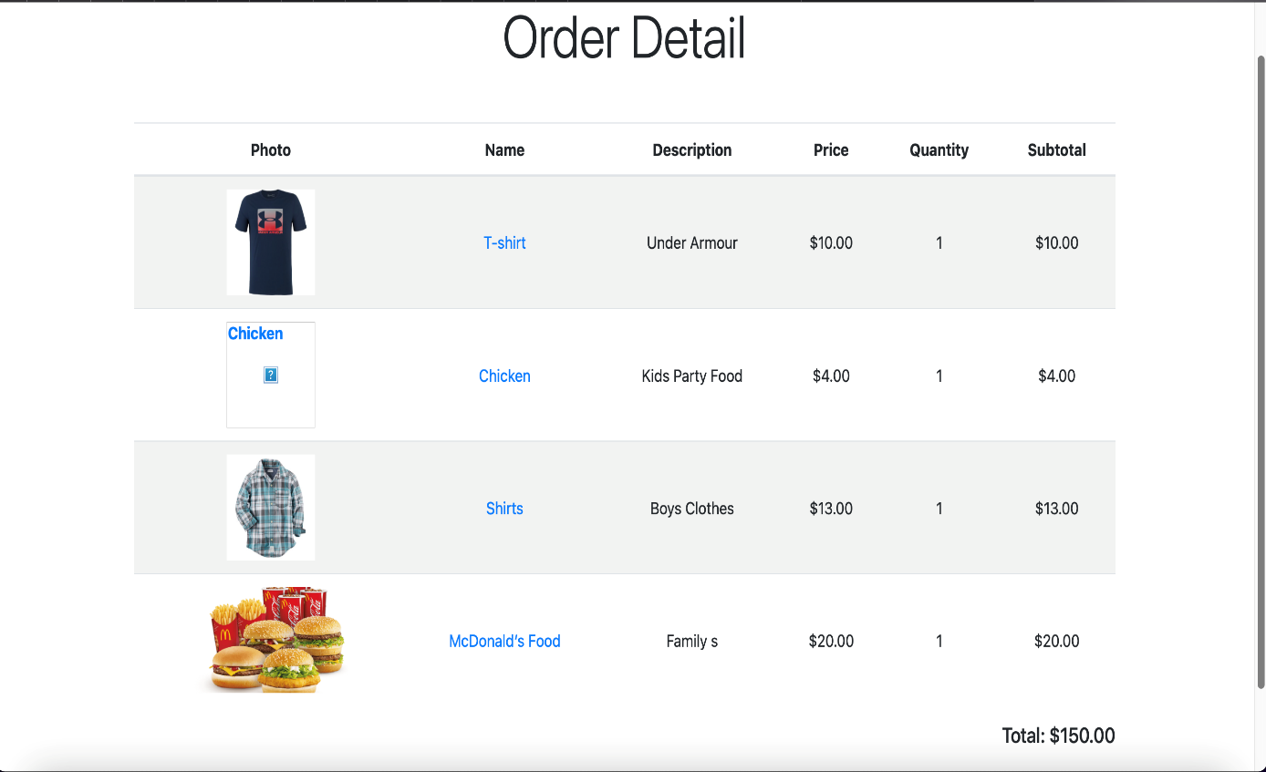
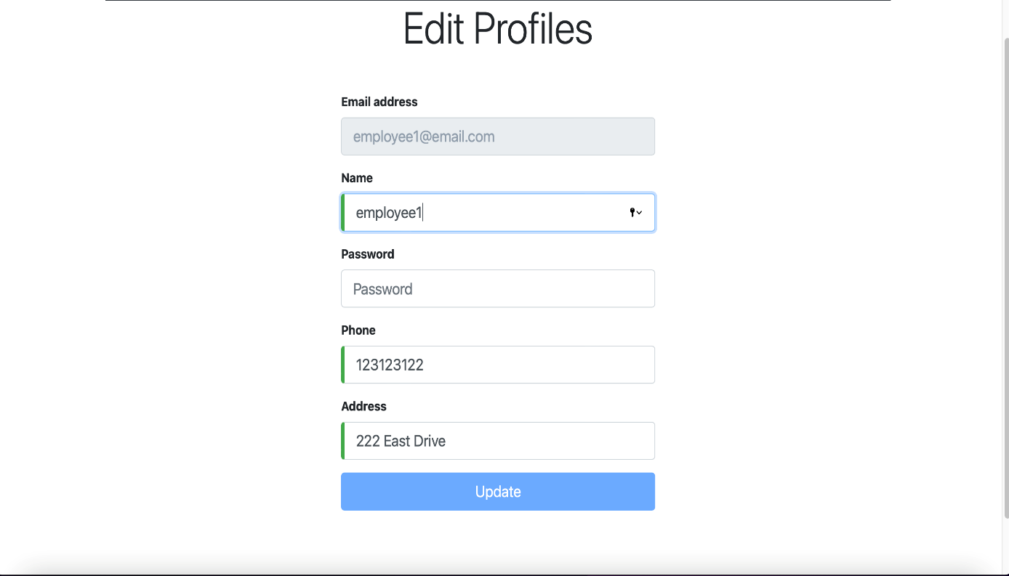

Slide 70
Additional Work (Research Paper):
During the winter break, I also published a research paper on “The effect of Amazon Web Services (AWS) on Cloud-Computing”, in International Journal of Engineering Research & Technology (IJERT). It was published in Vol. 10 Issue 11 during November, 2021.
This paper provides an insight about the effects of Amazon Web Services (AWS) on cloud computing. How the things have been changed in cloud computing after the introduction of AWS and how it has helped to solve some of the traditional drawbacks of cloud computing.
Check that out here:
https://www.ijert.org/the-effect-of-amazon-web-services-aws-on-cloud-computing

Slide 71
Conclusion:
The system has been implemented and tested successfully. It meets both functional and non-functional requirements specified to the great extent. Although the system has been designed keeping the present and future requirements in mind and made very flexible. But still there are some limitations of the system. Proper consideration has been given for a wide range of new enhancements. The system is developed in a user-friendly way. In future, if it is required to add new functionality in the system it can be simply achieved by just adding a separate module without affecting the design of the system, as our system properly follows MVC Architecture. It has helped us to properly maintain information about the distributors, customers, orders and medicine stocks. Furthermore, the maintenance of the project will become easy in future and transparency will be maintained.

Slide 72


THANK YOU

